Slide 1

Intelligent Recommender System
Movie Recommendation System using Python

Slide 2
Overview
Definition
Applications of Recommendation System
Types of recommenders
Concepts and technology used in the project
Challenges in development
Conclusion
References

Slide 3
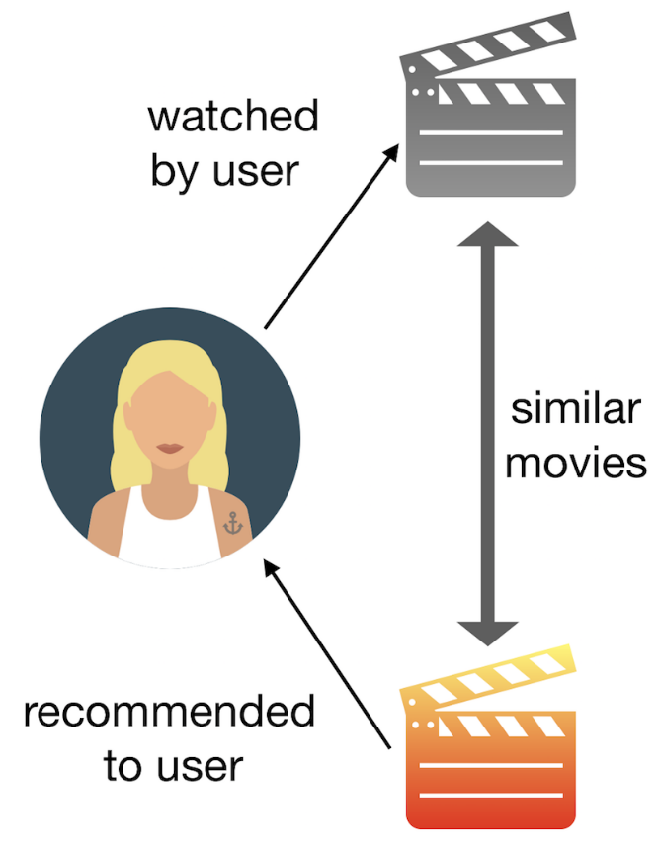
What is it a Recommendation System?
A recommender system is a type of information filtering system. By drawing from huge data sets, the system’s algorithm can pinpoint accurate user preferences.
Here’s an example of a recommender system that recommends movies.

Slide 4


Applications of Recommendation System
There are many applications of recommendation systems that can be observed in:
Movies and film industry.
Knowledge-based apps like Byjus.
Healthcare and retail product recommendations.
game recommendations in Xbox.

Slide 5
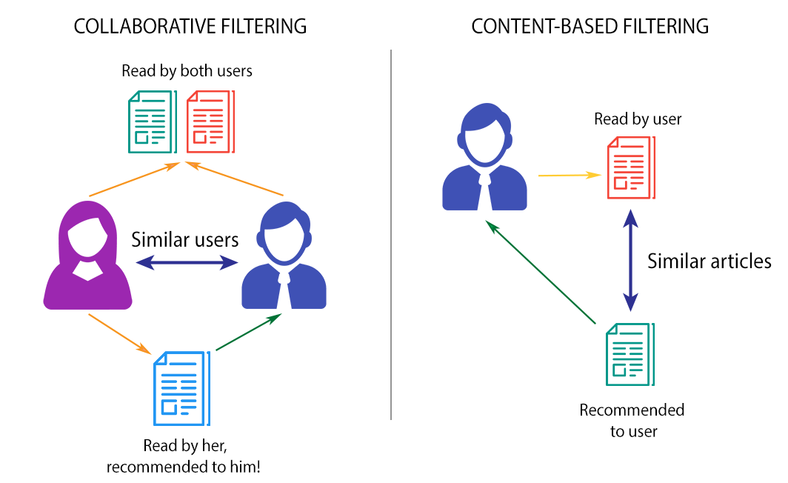
Types of Recommender Systems
Collaborative filtering system
Collaborative recommender system analyzes similarities between different kinds of content and it recommends based on the similarities.
Content-based system
Content based filtering uses the characteristics or properties of an item to serve recommendations.

Slide 6
Concepts and Technology
To design the Recommendation System, we need a few concepts that are:
Concepts: Pattern Recognition, Correlation, Cosine Similarity.
Language: Python (library: Numpy & Pandas), Sklearn. As far as the prototype development is concerned, we have support of a library (Scipy & Sklearn) that executes all the algorithms for us. All we need is a little Python and to use library functions.

Slide 7
What are Challenges in developing recommendation system?
Cold start: This problem arises when new users or new items are added to the system.
Privacy: Generally, an individual needs to feed his personal information to the recommendation system for more beneficial services
Latency: We observe many products are added more frequently to the database of recommendation systems, only already existing products are recommended to users as newly added products are not rated yet.

Slide 8
Conclusion
Do we really need recommendation systems?
For sure, the recommendation system is unturned to exist in the e-commerce businesses with the help of collaborative or content-based filtering to predict different items and yes, users are most satisfied with the products recommended to them.

Slide 9
References
https://github.com/
https://stackoverflow.com/
https://www.w3schools.com/python/python_reference.asp
https://www.geeksforgeeks.org/python-programming-language/?ref=shm

Slide 10


